Slide 1
One Axis Drill Project
Progress Report 03/06/2023

Slide 2
Goals to be met:
✔Mbaire- Do ANOVA analysis, get PMMA, work on Wit Motion+ RS232+ Arduino
✔ Renox- Work on ANOVA analysis, work on load cell+ hx711+ Arduino
✔ Katchiets - Power supply simulations in Proteus/ Multism for 5V, 3.3V from 12 supply currently at the setup; to be used in pcb
✔Steve- prepare a circuit diagram of how all components will come together on the PCB; demonstrating ability of Atmega2560 to handle all required components
✔ Allan and Morris- finish on mechanical design, incorporating detailed motor designs, Simulink modelling and running DC motor in simscape

Slide 3
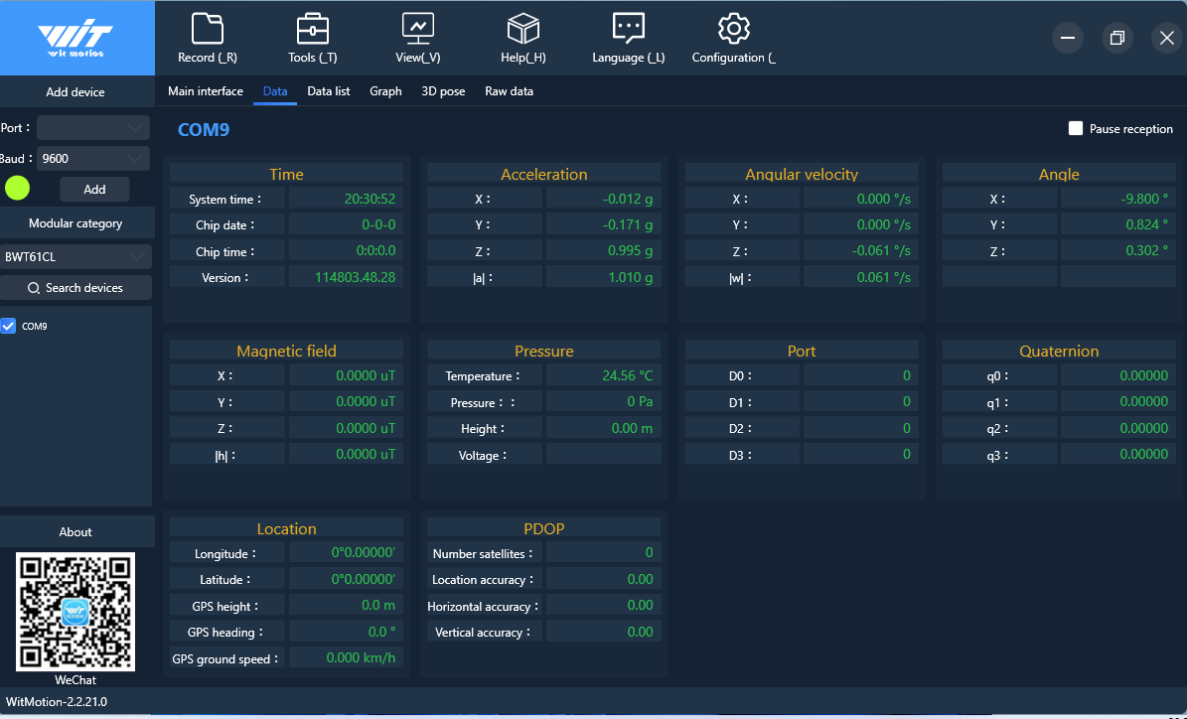
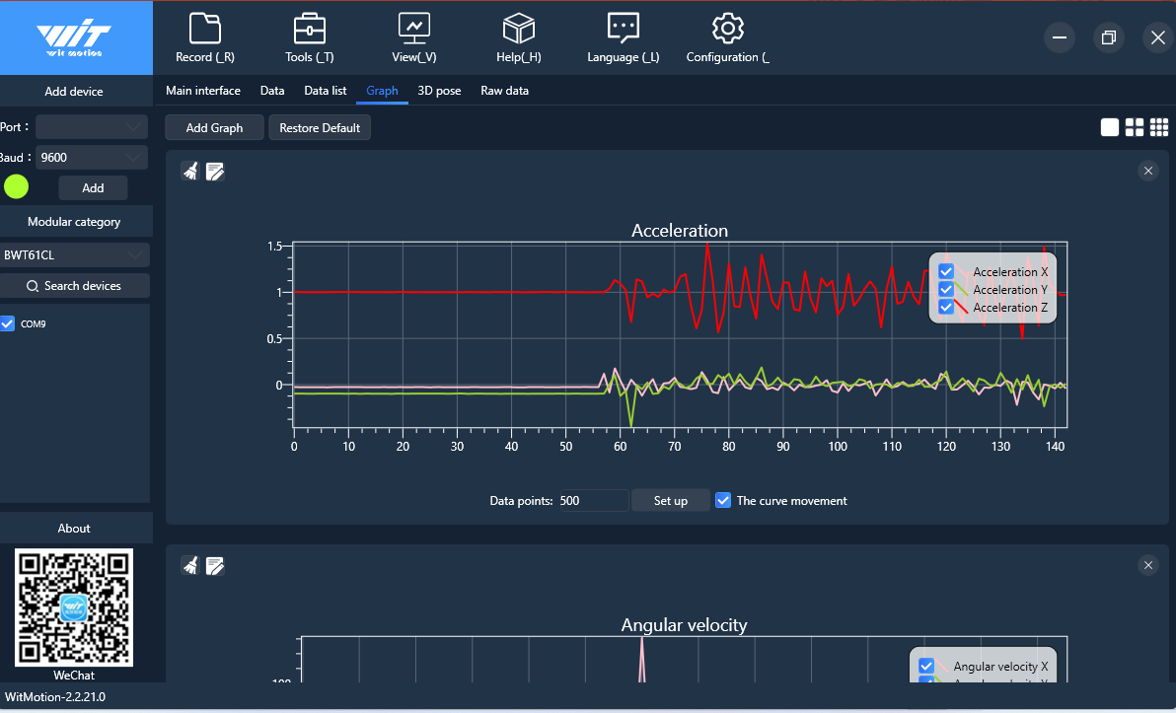
What has been achieved:
Reading data values of wit motion sensor using wit motion software and obtaining plots.

Slide 4
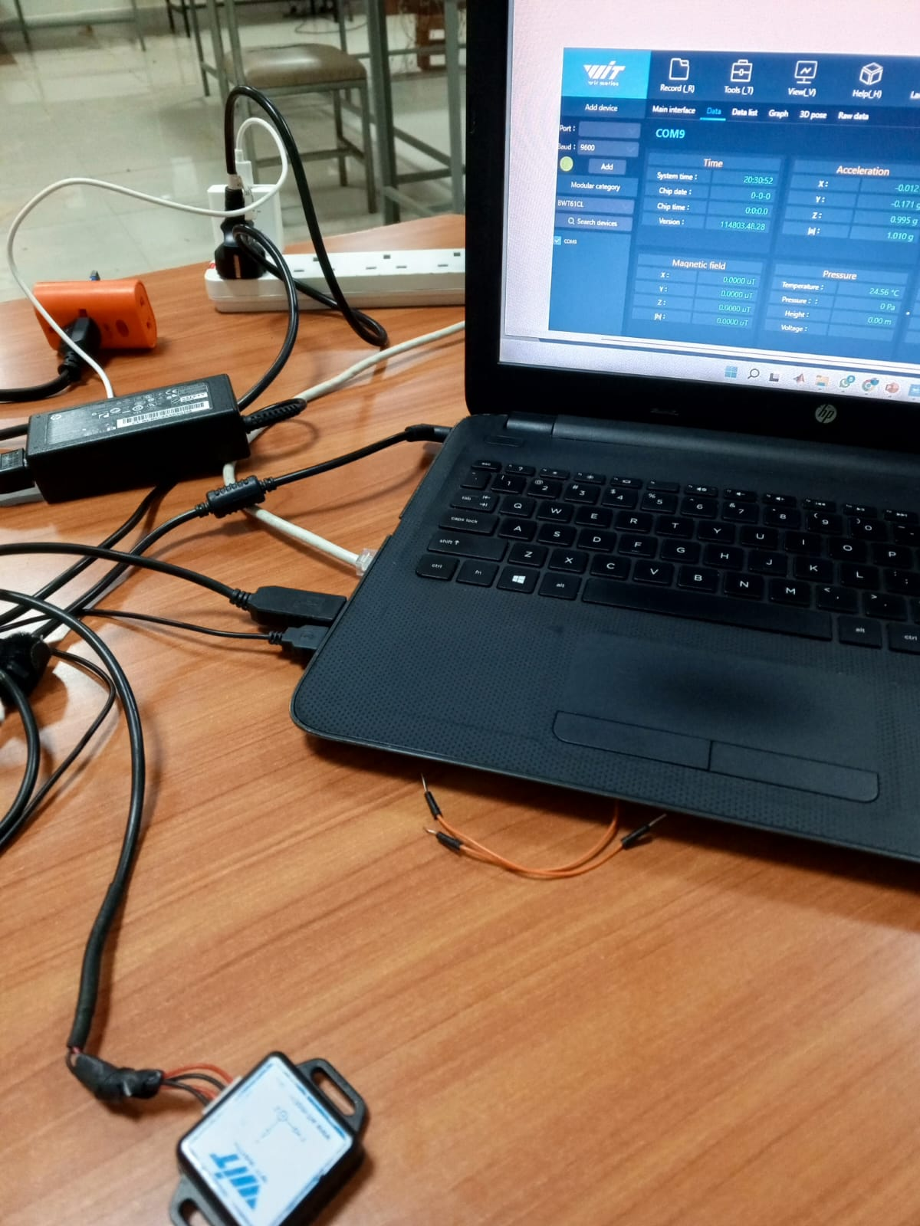
Wit motion continued…
Working physically

Slide 5
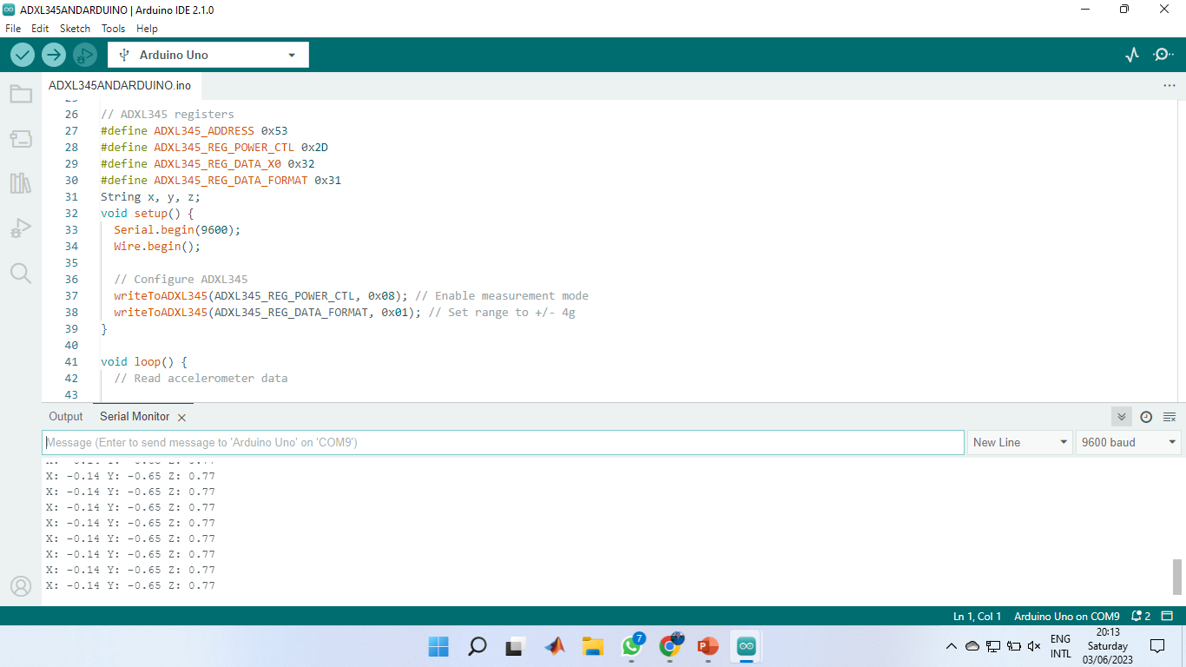
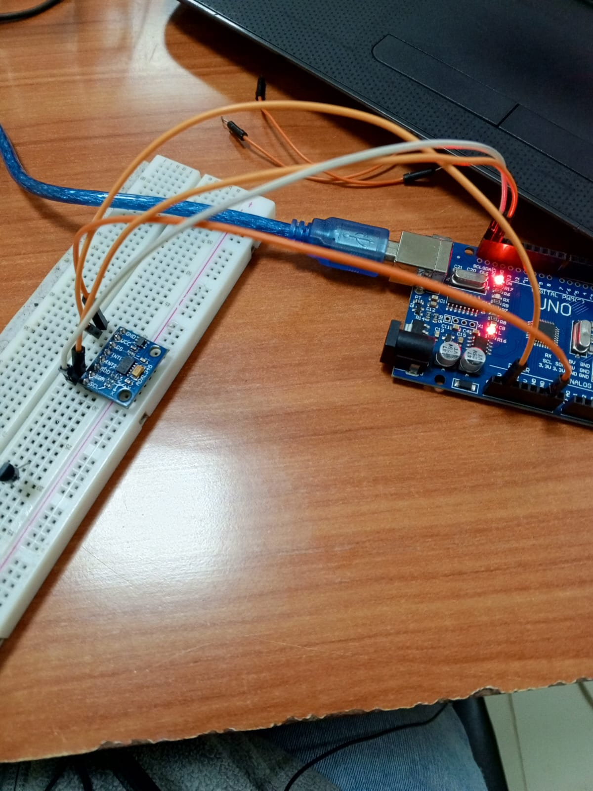
Using ADXL345 accelerometer to read analog values for vibration in X,Y and Z axes

Slide 6
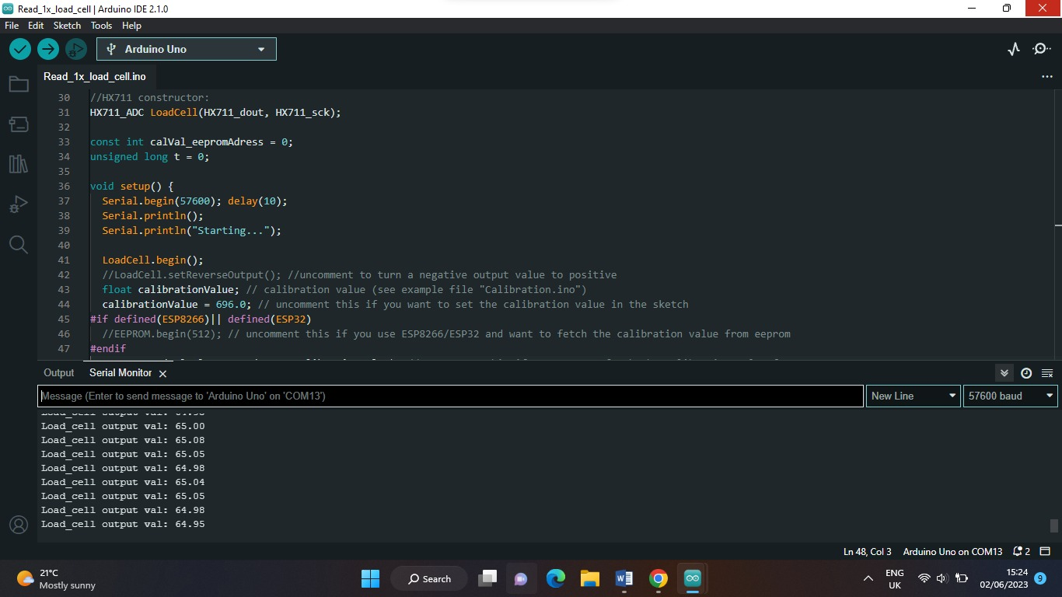
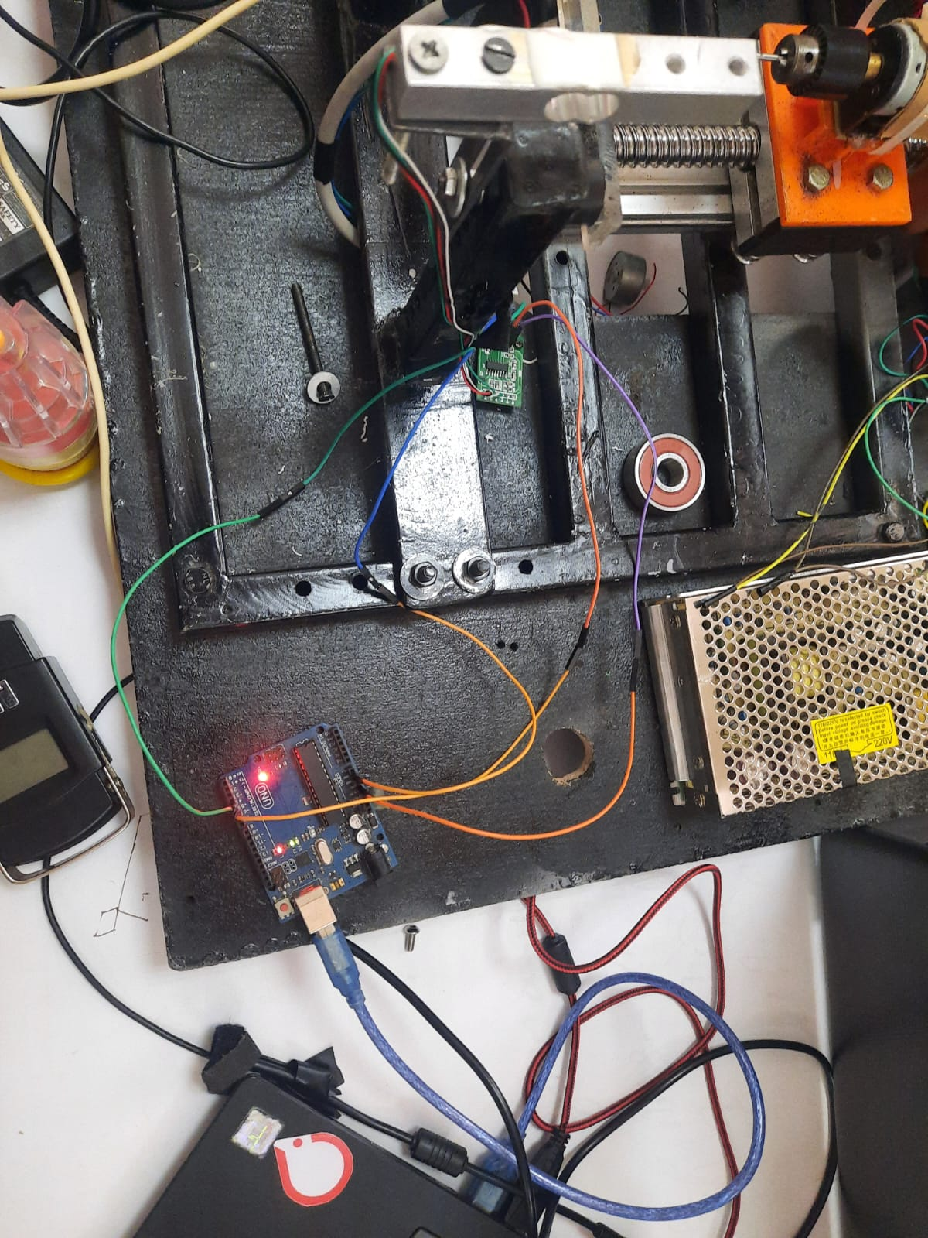
work on load cell+ hx711+ Arduino and calibrate sensor to measure force values

Slide 7
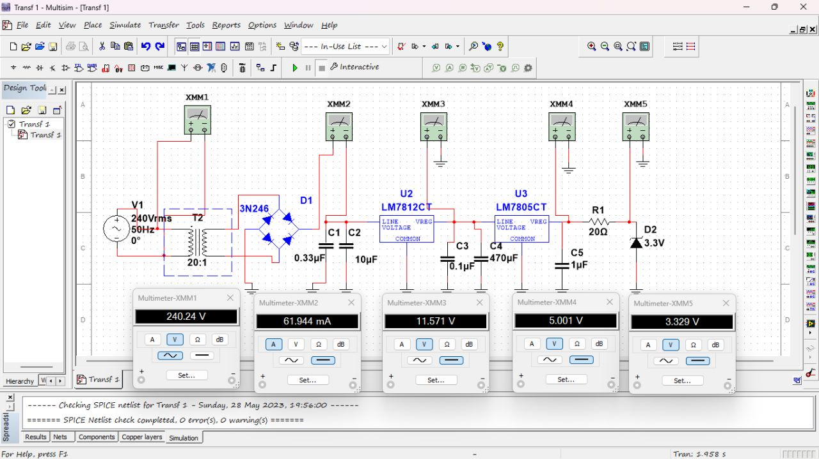
Power supply simulations in Proteus/ Multism for 5V, 3.3V from 12 supply currently at the setup; to be used in pcb

Slide 8
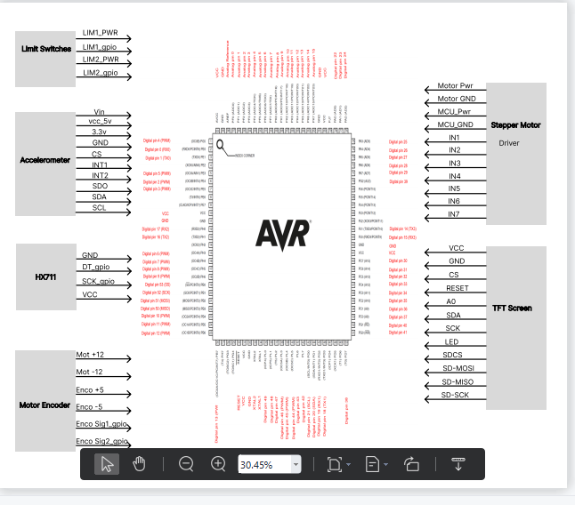
prepare a circuit diagram of how all components will come together on the PCB; demonstrating ability of Atmega2560 to handle all required components

Slide 9
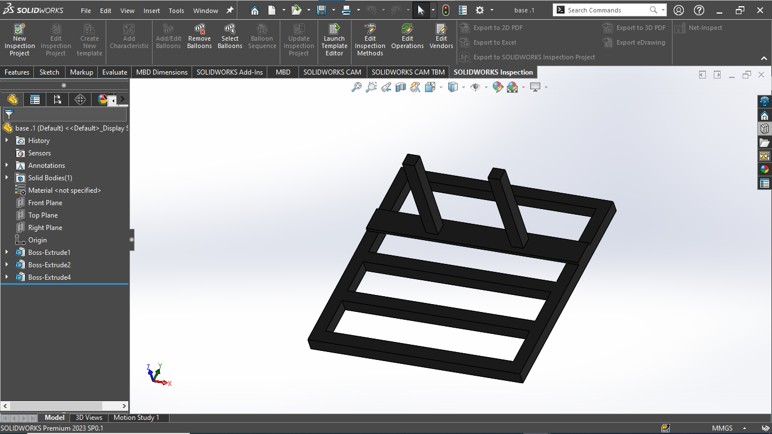
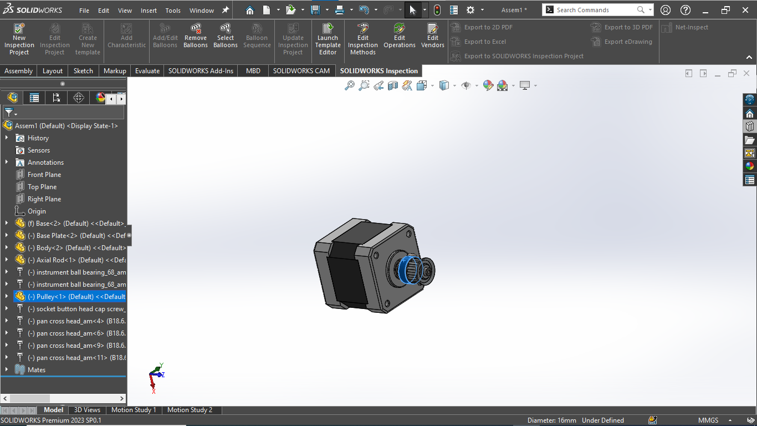
finish on mechanical design, incorporating detailed motor designs, Simulink modelling and running DC motor in simscape

Slide 10
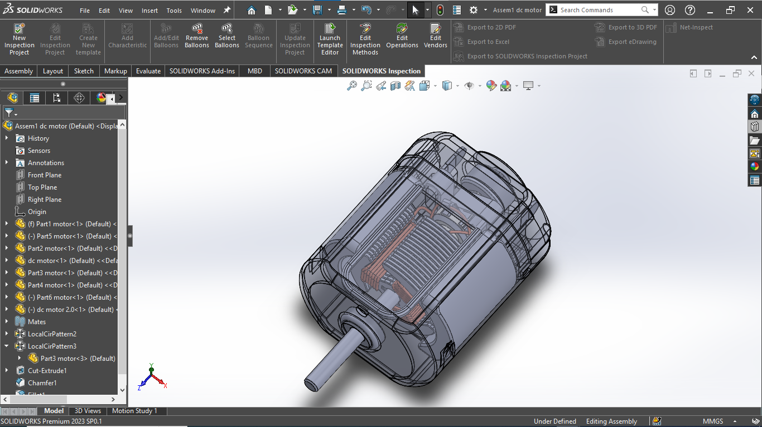
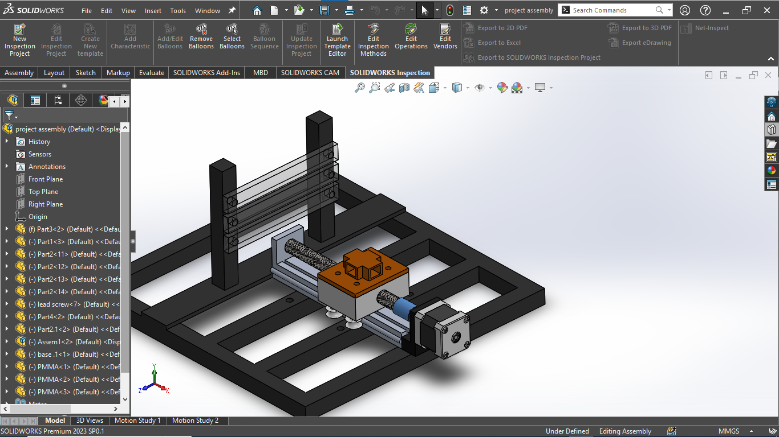
Mechanical assembly continued…

Slide 11
What has not been achieved yet:
ANOVA analysis- we have not been able to run the dc motor to provide rotary feed and stepper motor to provide linear feed simultaneously for drilling process. Currently working on it.
Simulink modelling of DC motor and addition of drill bit- in progress
Work on Wit Motion+ RS232+ Arduino- the wit motion sensor module cannot be configured to directly communicate with Arduino thus opted to use ADXL345 accelerometer for data collection and wit motion for data visualization.

Slide 12
Goals of coming week:
Get the DC motor and stepper motor to run concurrently for drilling process and ANOVA analysis
Finish on Simulink modelling of DC motor and DC motor assembly and full project mechanical simulation
Research on encoder interfacing with Arduino
More to be discussed in Monday’s meeting.

